Slide 1
TOPIC C:
CASE STUDY
LESSON C-2
PRE-ENGAGEMENT INTERACTIONS

Slide 2
AGENDA
Goals & target identification
Defining scope and & rules of engagement
Testing approaches
Ethical importance
NOTE!
Have a way to take notes and a way to write code available for this lesson

Slide 3

THE WARM UP QUESTION

Slide 4
THE WARM UP ANSWER

Slide 5
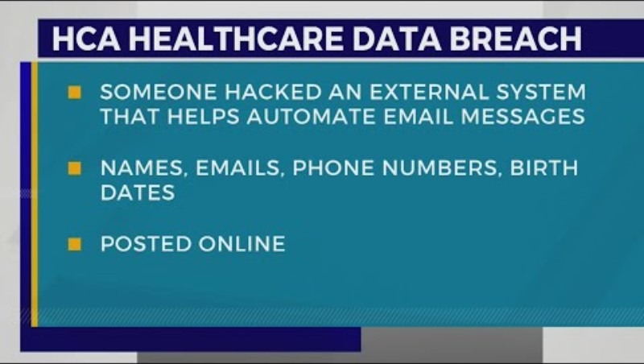
YES IT REALLY HAPPENS

Slide 6
REFLECTION
What could have gone wrong with their cybersecurity planning?
How could this organization have benefitted by having penetration testing conducted?

Slide 7
OUR CASE STUDY
Just like these hospitals, our CyberHealth Security holds sensitive patient information
  They also hold much less sensitive information, like email addresses and phone numbers
Of course, we don’t want any data to leak at all
  Prioritize important data

Slide 8
PRE ENGAGEMENT INTERACTION
But before we can do the testing, we’ll need to establish what the guidelines of this testing is
We do this through a few different strategies
  Goals and target identification
  Defining scope and rules of engagement
  Testing approaches
  Ethical importace

Slide 9
GOALS & TARGET IDENTIFICATION
After talking to MTPH (Med Tech Pro Health), we have identified their main concerns
These concerns may be:
  Patient data integrity (data safety)
  Uninterrupted service delivery (hospital remaining fully operational)
  Compliance with health regulations

Slide 10
GOALS & TARGET IDENTIFICATION
We should identify specific targets in the network
High risk areas that require specific attention specially noted
  Patient record databases
  Internet of Things enabled medical devices
    Any specific devices that connect to the internet
  What else might be a high risk area to note?

Slide 11
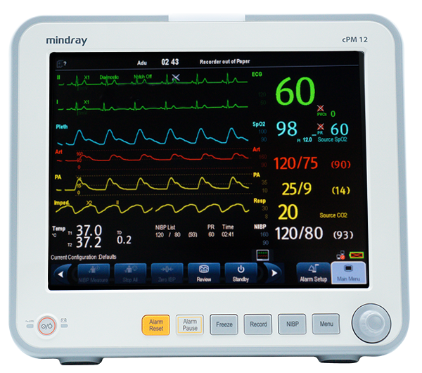
SCOPE & RULES OF ENGAGEMENT
We will decide the boundaries of the test ahead of time to avoid disruption
  If we start testing things willy nilly, we might take the hospital offline mid-surgery: big problem
Specify which systems we’re testing, and how much we’re testing them
Communicate our methods and extent of penetration testing to the hospital’s admins and our team

Slide 12
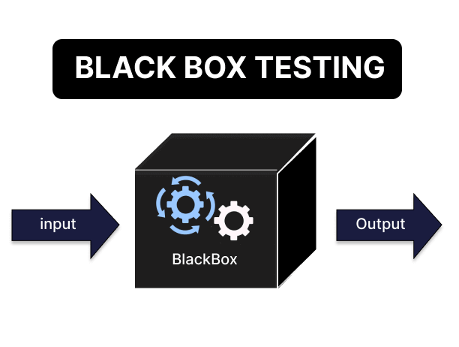
TESTING APPROACHES
There are three different testing approaches
  Black Box Testing – The team simulates an attack from the perspective of an uninformed external hacker
    This helps them to consider immediately available vulnerabilities

Slide 13
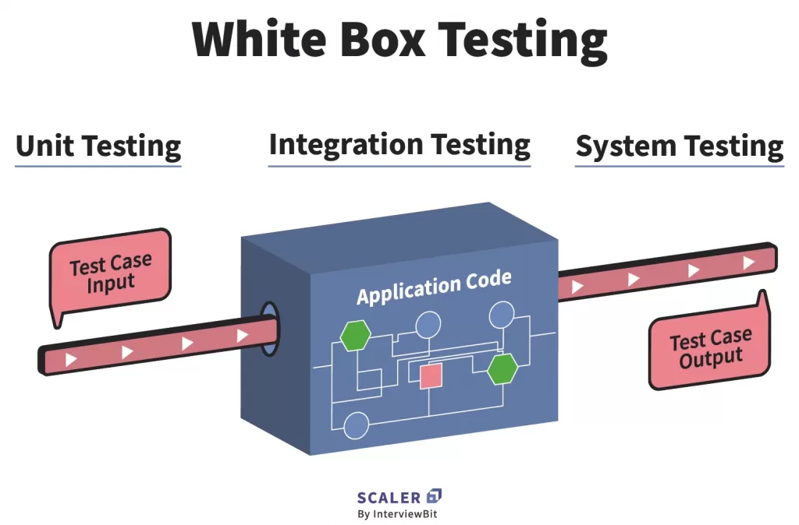
TESTING APPROACHES
White Box Testing – An in depth analysis with full knowledge of the hospital’s IT infrastructure
  Requires access to network diagrams, system configurations, and known vulnerabilities

Slide 14
TESTING APPROACHES
Grey Box Testing – Mixture of black and white box testing
  Partial knowledge of system
  Simulates insider threat/hacker with insider information

Slide 15
ETHICAL IMPORTANCE
Non-Disruption – Ensure that hospital functionality does not go down during times when patients may need it
Confidentiality – Even when infiltrating, protecting the private information that the hospital has is key
Authorization – Ensuring that private login information isn’t accessed that could provide a security risk isn’t leaked
  The last two could be addressed with a cloned system with fake data

Slide 16
ETHICAL IMPORTANCE
Element | Description | Example (MTPH context) | Ethical Concern
Goal setting | Define objectives | Protect patient data integrity | Data privacy
Scope | What systems to test | EHR servers only | Avoid disrupting life-support systems
Rules of engagement | Testing limits | No testing during surgery hours | Patient safety
Approach | Type of testing | Grey box testing | Balancing realism & safety

Slide 17
REFLECTION
Which testing approach do you believe is the most appropriate for MTPH?
Write out a short (paragraph with some bullet points) proposal to give to the MTPH admin about how you’d like to execute your penetration testing

